Slide 1
Unit : VI
Strategic Implementation

Slide 2
Strategy Implementation
No matter how brilliantly strategy is formulated, if not implemented properly, it will simply be a futile (fruitless) exercise.
Strategy implementation is "the process of allocating resources to support the chosen strategies“
Implementing strategy is the conversion of concepts into action and results. It is the total and detailed activities to fulfill the strategy and achieve the longterm objectives.
Robinson "to effectively direct and control the use of the firm's resources, mechanisms such as organizational structure, information systems, leadership styles, assignment of key managers, budgeting, rewards, and control systems are essential strategy implementation ingredients".
Steiner, "the implementation process covers the entire managerial activities including such matters as motivation, compensation, management appraisal, and control processes".

Slide 3
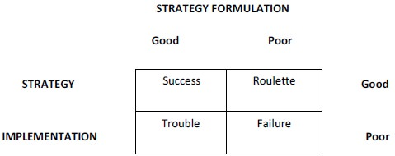
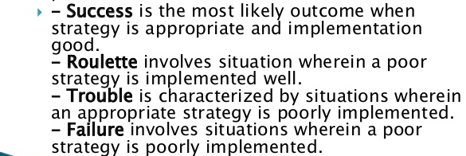
Relationship between formulation and implementation

Slide 4
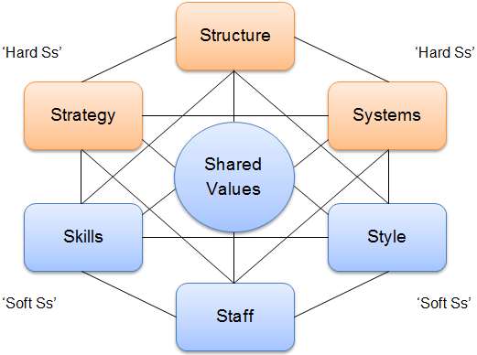
MCKINSEY 7-S
Structure, Strategy, Skills, Staff, Style, Systems, and Shared values, can be aligned together to achieve effectiveness in a company. The key point of the model is that all the seven areas are interconnected and a change in one area requires change in the rest of a firm for it to function effectively.
L.R. Jauch, and W.F. Glueck (1988). Business Policy and Strategic Management, McGraw Hill. 1988, 305.

Slide 5
MCKINSEY 7-S
In McKinsey model, the seven areas of organization are divided into the ‘soft’ and ‘hard’ areas. Strategy, structure and systems are hard elements that are much easier to identify and manage when compared to soft elements. On the other hand, soft areas, although harder to manage, are the foundation of the organization and are more likely to create the sustained competitive advantage.
Hard S | Soft S
Strategy | Style
Structure | Staff
Systems | Skills
 | Shared Values
Influenced by corporate culture
Influenced by Management

Slide 6
Strategy: is the one that’s clearly articulated, is long-term, helps to achieve competitive advantage and is reinforced by strong vision, mission and values.
Structure represents the way business divisions and units are organized and includes the information of who is accountable to whom.
Systems are the processes and procedures of the company, which reveal business’ daily activities and how decisions are made. Systems are the area of the firm that determines how business is done and it should be the main focus for managers during organizational change.
Skills are the abilities that firm’s employees perform very well.
Staff element is concerned with what type and how many employees an organization will need and how they will be recruited, trained, motivated and rewarded.
Style represents the way the company is managed by top-level managers, how they interact, what actions do they take and their symbolic value.
Shared Values the norms and standards that guide employee behavior and company actions

Slide 7
Steps of Strategy Implementation
Operationalization of Strategy
Managing
Conflict
Matching Strategy with Structure
Strategy Evaluation and Control
Restructuring and Reengineering
Creating Strategy Supportive Culture
Managing Resistance to Change
Linking Performance and Pay to Strategies

Slide 8
Operationalization of Strategy:
Annual Strategy
Functional Planning
  Financial Planning
  Marketing Planning
  Human Resources
  R&D Planning
  Production/ Operations Planning
  MIS
  General Management
Communications
Guidelines and Policies
Development of programs, budget and procedures
Matching Strategy with structure
Restructuring (i.e. right sizing) and
Reengineering (Process Mgmt, redesigning job, work process, service):
Linking Performance and pay to strategies: Salary increment, promotion should be closely aligned to support the long term strategic objectives. Gaining sharing application…
Managing Resistance to Change
Creating a strategy supportive culture
Strategy evaluation and control

Slide 9
Matching structure with strategy
Changes in strategy often require changes in the way an organization is structured for two major reasons.
First, structure largely dictates how objectives and policies will be established. For example, objectives and policies established under a geographic organizational structure are couched in geographic terms.
The second; structure dictates how resources will be allocated. If an organization’s structure is based on customer groups, then resources will be allocated in that manner. Similarly, if an organization’s structure is set up along functional business lines, then resources are allocated by functional areas.

Slide 10
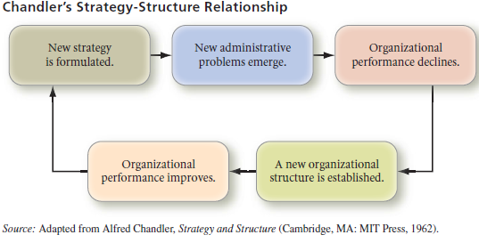
Changes in strategy lead to changes in organizational structure. Structure should be designed to facilitate the strategic pursuit of a firm and, therefore, follow strategy. Without a strategy or reasons for being (mission), companies find it difficult to design an effective structure. Chandler found a particular structure sequence to be repeated often as organizations grow and change strategy over time

Slide 11
Type of Structure
Simple Structure
Functional Structure
Multi Divisional Structure
SBU Structure
Holding company Structure (Comp A, B,C under parent company)
Project Based structure (Project A, B,C)
Matrix Structure
Team based structure
Network structure
Multinational company structure
Refer to previous readings:

Slide 12
Annual Objectives
Financial objectives of FY 2021/22
1.

Slide 13
Resource Allocation
Resource allocation is a central management activity that allows for strategy execution.
Strategic management enables resources to be allocated according to priorities established by annual objectives.
All organizations have at least four types of resources that can be used to achieve desired objectives: financial resources, physical resources, human resources, and technological resources.
The real value of any resource allocation program lies in the resulting accomplishment of an organization’s objectives.
Effective resource allocation does not guarantee successful strategy implementation because programs, personnel, controls, and commitment must breathe life into the resources provided. Strategic management itself is sometimes referred to as a “resource allocation process.”

Slide 14
Resource Allocation Planning
An Effective resource Planning gives answer
Q. Does the organization have required resources to execute the given strategies successfully ?
Q. Are the strategies of the organization being shaped to capitalize on the current resources ?
Q. What are the process of allocating the resources at the corporate and business level ?

Slide 15
Process of Resource Allocation
Define Mission
Assess the current inventory of resources
Assess and acquire the required resources
Allocate the resources

Slide 16
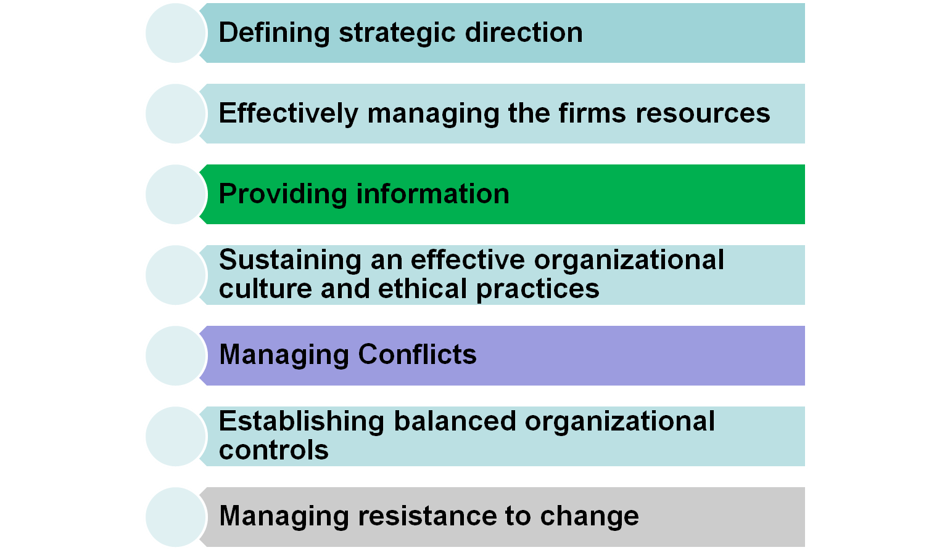
Role of Strategic Leadership in Strategy Implementation

Slide 17
Operationalization of Strategies
Annual Objectives
Functional Planning (Finance, Marketing, HR, R&D, Productions, MIS and General Management)

Slide 18
Long-Term Objectives
Long-term objectives represent the results expected from pursuing certain strategies. Strategies represent the actions to be taken to accomplish long-term objectives.
Objectives are commonly stated in terms such as growth in assets, growth in sales, profitability, market share, degree and nature of diversification, degree and nature of vertical integration, earnings per share, and social responsibility.
Clearly established objectives offer direction, allow synergy, aid in evaluation, establish priorities, reduce uncertainty, minimize conflicts, stimulate exertion (application), and aid in both the allocation of resources and the design of jobs

Slide 19
Policies
Policy refers to specific guidelines, methods, procedures, rules, forms, and administrative practices established to support and encourage work toward stated goals. Policies are instruments for strategy implementation. Policies set boundaries, constraints, and limits on the kinds of administrative actions that can be taken to reward and sanction behavior; they clarify what can and cannot be done in pursuit of an organization’s objectives.
Changes in a firm’s strategic direction do not occur automatically. On a day-to-day basis, policies are needed to make a strategy work. Policies facilitate solving recurring problems and guide the implementation of strategy.
Policies let both employees and managers know what is expected of them, thereby increasing the likelihood that strategies will be implemented successfully
Wal-Mart has a policy that it calls the “10 Foot” Rule, whereby customers can find assistance within 10 feet of anywhere in the store.

Slide 20
Functional Tactics
Functional tactics are the key, routine activities that must be undertaken in each functional area to provide the business’s products and services
In a sense, functional tactics translate thought into action
Every value chain activity in a company executes functional tactics that support the business’s strategy and help accomplish strategic objectives
10-<number>

Slide 21

Outsourcing Functional Activities
Outsourcing is acquiring an activity, service, or product necessary to provide a company’s products or services from “outside” the people or operations controlled by that acquiring company
Outsourcing can save valuable time and money for many organizations
10-<number>

Slide 22
Functional tactics to operationalize strategy
Functional tactics are short-term activities each functional area within the firm undertakes to implement the grand strategy. And while they are "short-term," they are perhaps better characterized as "day-to-day" activities that implement strategic plans.

Slide 23
What are Functional Tactics?
Key, routine activities that must be undertaken in each functional area to provide the business products.
Translate grand strategies into action designed to accomplish specific short-term objectives

Slide 24
Functional Tactics
Function Tactics in Production/Operations:
Viewed as core function of an organization
Involves converting inputs into value-enhanced output
Focuses on decisions regarding
  Basic nature of firm’s POM system,
    Seeks optimum balance between investment input and production/operations output
  Location
  Facilities design
  Process planning on a short-term basis

Slide 25
Functional Tactics
Functional Tactics in Marketing
  Marketing tactics:
Lead to the strategic success of the firm through the profitable sale of product/services in target markets
Clearly identify customer needs that products/services aim to meet
Identify where, when, and by whom products/services are to be sold
Define how the firm will communicate with target markets
Directly influence supply, demand, profitability, consumer perception, and regulatory response through pricing.

Slide 26
Functional Tactics
Functional Tactics in Finance and Accounting
Time frame of finance tactics varies because they direct use of financial resources supporting the business strategy, long-term goals, and annual objectives
Long-term tactics guide decisions in
  Long-term capital investment
  Debt financing
  Dividend allocation
  Leveraging
Short-term tactics guide decisions in
  Managing working capital and short-term assets
Accounting-focused tactics have taken on increased strategic significance in last decade

Slide 27
Key Functional Tactics in Finance and Accounting
Functional Tactic
Typical Questions the Functional Tactic Should Answer
Capital acquisition
What is an acceptable cost of capital?
What is desired proportion of short- and long-term debt? Preferred and common stock?
What balance is desired between internal and external funding?
What risk and ownership restrictions are appropriate?
What level and forms of leasing should be used?
Capital allocation
What are the priorities for capital allocation projects?
On what basis should the final selection of projects be made?
What level of capital allocation can be made by operating managers without higher approval?

Slide 28
Functional Tactics in Research and Development: With the increasing rate of technological change in most competitive industries, R&D has assumed a key strategic role in many firms.
Key Functional Tactics in R&D
Functional Tactic
Typical Questions the Functional Tactic Should Answer
Basic research vs. product and process development
To what extent should innovation and breakthrough research be emphasized? In relation to the emphasis on product development, refinement, and modification?
What critical operating processes need R&D attention?
What new products are necessary to support growth?
Time horizon
Is the emphasis short-term or long-term?
Which orientation best supports the business strategy? The marketing and production strategy?

Slide 29
Key Functional Tactics in HRM
Functional Tactic
Typical Questions the Functional Tactic Should Answer
Recruitment, selection, and orientation
What key human resources are needed to support chosen strategy?
How do we recruit these human resources?
How sophisticated should our selection process be?
How should we introduce new employees to the organization?
Career development and training
What are our future human resource needs?
How can we prepare our people to meet these needs?
How can we help our people develop?
Compensa-tion
What levels of pay are appropriate for the tasks we require?
How can we motivate and retain good people?
How should we interpret our payment, incentive, benefit, and seniority policies?

Slide 30
Differences between Business Strategies and Functional Tactics
Three basic characteristics that differentiate functional tactics from business strategies:
Time Horizon: focus on immediate activities.
Specificity: business strategies provide general direction, functional tactics specify activities and how they are expected to be achieved
Participants: general managers are responsible for business strategies. Operating managers establish short-term objectives and functional tactics that lead to business-level success.

Slide 31
Differences Between Business Strategies and Functional Tactics
Time Horizon
Specificity
Participants
Shorter time horizon of functional tactics contributes to successful implementation by
  Focusing attention on what needs to be done now
  Allowing functional managers to adjust to changing current conditions
Greater specificity of functional tactics contributes to successful implementation by
  Ensuring functional managers focus on accomplishments
  Clarifying for top managers how functional managers intend to accomplish business strategy
  Facilitating coordination among operating units
General managers establish long-term objectives and overall business strategies
Operating managers establish short-term objectives and functional tactics leading to business level success

Slide 32
Managing Conflict
Conflict can be defined as a disagreement between two or more parties on one or more issues.
Establishing annual objectives can lead to conflict because individuals have different expectations and perceptions, personalities are incompatible, and misunderstandings between line managers (such as production supervisors) and staff managers (such as human resource specialists) occur.
Conflict is unavoidable in organizations, so it is important that conflict be managed and resolved before dysfunctional consequences affect organizational performance.

Slide 33
Managing Conflict
Approaches for managing and resolving conflict
Avoidance includes such actions as ignoring the problem in hopes that the conflict will resolve itself or physically separating the conflicting individuals (or groups)
Diffusion can include playing down differences between conflicting parties while accentuating (emphasize) similarities and common interests, compromising so that there is neither a clear winner nor loser, resorting to majority rule, appealing to a higher authority
Confrontation is exemplified by exchanging members of conflicting parties so that each can gain an appreciation of the
other’s point of view or holding a meeting at which conflicting parties present their views and work through their differences

Slide 34
Employees empowerment
Empowerment is the act of strengthening employees’ sense of effectiveness by encouraging them to participate in decision making and to exercise initiative and imagination, and rewarding them for doing so.
Managers and employees become surprisingly creative and innovative when they understand and support the firm’s mission, objectives, and strategies. A great benefit of strategic management, then, is the opportunity that the process provides to empower individuals.

Slide 35
Empowering Operating Personnel: Policies
Empowerment is the act of allowing an individual or team the right and flexibility to make decisions and initiate action
Empowerment in organizations is being created in many ways. Training, self-managed work groups, eliminating whole levels of management in organizations, and aggressive use of automation
Policies are directives designed to guide the thinking, decisions, and actions of managers and their subordinates in implementing a firm’s strategy
10-<number>

Slide 36
Creating Policies that Empower or How Policies Empower People ?
Policies establish indirect control over independent action by clearly stating how things are to be done now.
Policies promote uniform handling of similar activities.
Policies ensure quicker decisions by standardizing answers to previously answered questions.
Policies institutionalize basic aspects of organization behavior.
Policies reduce uncertainty in repetitive and day-to-day decision making.
Policies counteract resistance to or rejection of chosen strategies by organization members.
Policies offer predetermined answers to routine problems.
Policies empower people to act.
Compensation, at least theoretically, rewards their action.

Slide 37
OK. DONE
Unit VII

Slide 38
Types of Executive Bonus Compensation
Bonus Type
Description
Rationale
Shortcomings
Stock option grants
Right to purchase stock in the future at a price set now; compensation determined by “spread”
Provides incentive for executive to create wealth for shareholders as measured by increase in firm’s share price
Movement in share price does not explain all dimensions of managerial performance
Restricted stock plan
Shares given to executive who is prohibited from selling them for a specific time period
Promotes longer executive tenure than other forms of compensation
No downside risk to executive, who always profits unlike other shareholders
Golden handcuffs
Bonus income deferred in a series of annual installments; forfeited with executive resignation
Offers an incentive for executive to remain with the firm
May promote risk-averse decision making due to downside risk borne by executive

Slide 39
Types of Executive Bonus Compensation
Contd...
Bonus Type
Description
Rationale
Shortcomings
Golden parachute
Executive has right to collect bonus if loses position due to takeover, firing, retirement, or resignation
Offers an incentive for executive to remain with firm
Compensation is achieved whether or not wealth is created;rewards either success or failure
Cash based on internal performance using finance measures
Bonus compensation based on accounting performance measures such as return on equity
Offsets limitations of focusing on market-based measures of performance
Weak correlation between earnings measures and shareholder wealth creation

Slide 40



Compensation Plan Selection Matrix
Type of Bonus Compensation
Strategic Goal
Cash
Golden Handcuffs
Golden Parachutes
Restricted Stock Plans
Stock Options
Rationale
Achieve corporate turnaround
X
Executive profits only if turnaround is successful in returning wealth to shareholders
Create and support growth opportunities
X
Risk associated with growth strategies warrants use of this high-reward incentive
Defend against unfriendly takeover
X
Helps remove temptation for executive to evaluate takeover based on personal benefits
Evaluate suitors objectively
X
Compensates executive if job is lost due to a merger favorable to the firm
Globalize operations
X
Risk of expanding overseas requires a plan that compensates only for achieved success
Grow share price incrementally
X
Accounting measures can identify periodic performance benchmarks

Slide 41



Compensation Plan Selection Matrix (concluded)
Type of Bonus Compensation
Strategic Goal
Cash
Golden Handcuffs
Golden Parachutes
Restricted Stock Plans
Stock Options
Rationale
Improve operational efficiency
X
Accounting measures represent observable and agreed-upon measures of performance
Increase assets under management
X
Executive profits proportionally as asset growth leads to long-term growth in share price
Reduce executive turnover
X
Handcuffs provide executive tenure incentives
Restructure organization
X
Risk associated with major change in firm’s assets warrant use of this high-reward incentive
Streamline operations
X
Rewards long-term focus on efficiency and cost control

Slide 42
STRATEGIC LEADERSHIP AT GENERAL ELECTRIC: 1947 TO 1997
General Electric - An Introduction
July 1997 - Business Week issue cited GE as “Most Valuable Company” with worldwide market capitalization of $198.09 billion.
GE - established in 1878 with a group of investors joining together to finance Edison’s incandescent lamp.
Company grew; by 1939 sales $342 million; due to WWII increased to $1.4 billion in 1943.
Case illustrate systematic implementation of strategic planning at GE to market performance in four phases over a span of 50 years - 47 to 97.

Slide 43
STRATEGIC LEADERSHIP AT GENERAL ELECTRIC: 1947 TO 1997
Contd...
Phase I: Coordiner’s Enterpreneurial Era
1947 CEO Charles Wilson tells Cordiner to study managing the fast paced growth.
Cordiner identified three areas of change - (1) More decentralized decision making (2) Long range planning system and (3) More entrepreneurial minded managers to meet growth challenges.
1950 - Cordiner becomes CEO, Identifies GE’s new “Marketing Concept” PR I, PR II, (SP) (Target)
This phase originated the GE Strategic Planning concept

Slide 44
STRATEGIC LEADERSHIP AT GENERAL ELECTRIC: 1947 TO 1997
Contd...
Phase I: Coordiner’s Enterpreneurial Era
Think like entrepreneurs
Make markets and customer values central focus for strategic planning
Once market opportunities identified, plan and make resource allocations.
Plan so that available resources can be leveraged for long term objectives.
Managers evaluated on performance against intermediate goals set in long term plan.
“Reinvest” profits for long-term goals

Slide 45
STRATEGIC LEADERSHIP AT GENERAL ELECTRIC: 1947 TO 1997
Contd...
Phase II: Borch and Implementing Strategic Planning Concept (63 to 71)
1963 - Borch succeeds Cordiner as CEO inheriting three problems
(1) Implementing and integration of marketing concept
(2) Greater corporate control over 70 semi-independent division vice-presidents
(3) Reviewing and presentation process for BSU plans too bureaucratic
With aid of Mckinsey Borch integrates marketing concept in GE’s system with the development of Strategic Business Units (Staff / Line Groups)
Again withMcKinsey’s aid identifies the method for developing and managing SBUs through the concept of Portfolio Management

Slide 46
STRATEGIC LEADERSHIP AT GENERAL ELECTRIC: 1947 TO 1997
Contd...
Phase III: Implementing Strategic Planning Concept (72 to 81)
1972 - Reginald Jones succeeds Borch
Identified six important sectors which divided GE’s business into six broad areas.
Sector vice-presidents named to plan and have related units reporting to them. They would report to two senior vice-chairman.
Enabled strategic planning concept to become worldwide concept
Simplified presentations of SBU plans-without visual aids. Review layers in SBU plans reduced from 43 to 6.
Six strategic sectors in which GE will compete in for the future; GE’s intent for venturing for alliances around the world.

Slide 47
STRATEGIC LEADERSHIP AT GENERAL ELECTRIC: 1947 TO 1997
Contd...
Phase IV: Welch: Strategic Thining and Visionary Leadership
1981 - Jack Welch becomes CEO
Two basic objectives: SBUs should be number one or two in their markets; compete in three interrelated “circles” (high technology markets, service markets, core market- engines, appliances etc.).
Long term “stretch” goals-externally oriented for comparisons against total market. Incremental goals internally oriented.
Renetrated newer markets - India, China, Mexico
Removed layers of management and bureaucracy in planning process. One page Reports submitted on key issues.
Formulated strategy for 21st century - penetrate global market; service contracts with large customers of both GE and non-GE equipment.

Slide 48
Learning From GE
Focus on improving both internally and externally
Marketing Concept - without marketing’s input strategic planning is useless.
Disciplined yet flexible approach- SBU managers free to use any methods to analyze markets and operate.
Focus on long-range performance and fit rather than incremental gains.
CEO - selection is of utmost importance and central to strategic planning

